Slide 1
AMOEBIC LIVER ABSCESS
Dr Sowmya R S G
Assistant Professor
Dept of Pathology

Slide 2
Amoebic abscess is a complication of amoebic dysentry which is caused by entamoeba histolytica.
Pathology:
The protozoa passes from the colonic lesion via the portal vein into the liver, usually into the upper and posterior portions of right lobe
′ Liver infection begins with intrahepatic portal thrombosis and infarction, the cytolytic activity starts and leads to liquefaction of the surrounding stromal and parenchymal structures, resulting in formation of large single abscess.
′ 30% have more than one abscess.
′

Slide 3
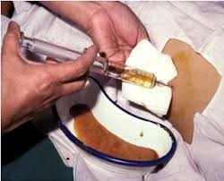
Gross appearance:
′ Liver is usually enlarged
′ The liquefied material within the abscess is characteristically viscid and semitransparent. Content is mixture of rbcs, leucocytes, broken down liver cells and this looks reddish brown coloured and is described as choclate sauce or anchovy sauce.
′ In early cases, wall of abscess is thin with little fibrosis whereas older cases have a fibrous capsule.

Slide 4
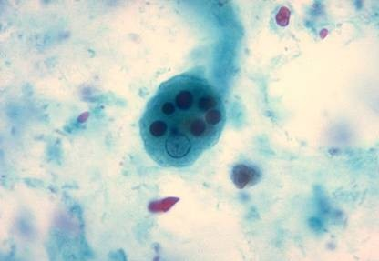
Microscopically: 3 zones are recognized,
Central necrotic zone
Middle zone showing destruction of parenchymal cells
Outer zone which is adjacent to the fibrous capsule and in which amoeba are demonstrated, earlier the stage more likely that the amoeba will be found.
Secondary infection with staphylococci, streptococci and Esterechia coli is found in half the cases otherwise the pus is sterile.

Slide 5
Clinical features:
′ Amoebic abscess develops after attack of amoebic dysentry
′ It may also develop even in a carrier who hasn’t shown definite symptoms and signs of amoebic dysentry
′ Though anemia and loss of weight are first to appear, yet the typical symptoms are

Slide 6
Fever- upto 39”C or even more particularly at night, associated with chills and sweating. Unless its complicated by secondary infection the temperature is usually less than that of pyogenic. Pain- is usually felt over the right lower intercostal spaces but the site of pain is usually related to the location of hepatic abscess.

Slide 7
′ Superior surface abscess may cause pain referred to the right shoulder
′ Tender hepatomegaly is often seen, tenderness and rigidity is felt just below the right costal margin. If left lobe is involved then tender swelling in epigastrium
′ Unfortunately only one-third to half the patients offer history of previous diarrhoea, clinical jaundice is rare, abnormal pulmonary signs may also be looked for.

Slide 8
Complications:
Prognosis is better than pyogenic but if untreated, it may burst into
Right pleural cavity- resulting in empyema
Right lung- causing bronchohepatic fistula, lung abscess or pneumonia
Peritoneal cavity or even the pericardial cavity if there is single large abscess of the left lobe
Rarely, the amoebic abscess may extend into kidney as well.

Slide 9
Investigations:
′ Blood examination- leucocytosis in early cases, anemia in chronic cases
′ Serological tests like Indirect hemagglutination and Complement fixation tests to detect antibodies are useful. Negative titres exclude amoebic abscess as a diagnostic possibility.
′ Diagnosis is 100% confirmed by aspiration of liver abscess, anchovy sauce is quiet diagnostic
′

Slide 10
Sigmoidoscopy reveals characteristic amoebic ulcers ′ Radiography often reveals elevation and fixation of right half of diaphragm ′ Liver function tests and examination of stool for amoebae and are not useful.

Slide 11
Needle aspiration- Indications are
′ Persistence of clinical features of amoebic abscess following a course of amoebicidal drugs
′ Clinical or radiological evidence of presence of hepatic abscess
Drug therapy should be instituted several days before aspiration, no drug should be injected directly into the abscess cavity.

Slide 12
Technique - Should be done in OT under guidance of USG or CT, long needle with wide bore is selected. Preferred route is through 9th ICS or 10th ICS between anterior and posterior axillary line.

Slide 13
Surgical drainage of abscess:
This carries great morbidity and mortality, its only indicated
′ when abscess is secondarily infected as evident by needle aspiration
^{′ Amoebic peritonitis}

